Slide 1
Introduction to the
Future Freight Flows
Scenario Planning Workshop
Your Name
Date
Organization
Notes:
These slides are intended to be used by a facilitator at a Future Freight Flow (FFF) Scenario Planning workshop. The slides were developed as part of the Scenario Planning Toolkit for the NCHRP 20-83-(01) Project.
The notes are meant to help the facilitator make key points – they are not meant to be used as a script.

Slide 2
Agenda
[insert the day’s agenda here]
Notes:
Lay out the course of the day to include breaks etc.

Slide 3
Freight Transportation Planning is Hard.
Hard for shippers,
Harder for carriers,
Hardest for government planners!
  Infrastructure planning timeframe is decades
  Diverse and vocal constituents (NIMBY, BANANA)
  Pallets don’t vote
  Both modal and jurisdictional silos
  Revenue sources are decreasing dramatically
  Removed from the system users
These challenges were recognized by AASHTO and were a reason why the NCHRP 20-83 Projects were created.
Notes:
This slide is intended to set the stage for all of the invited participants. It is designed to let shippers and carriers understand the difficulties that government planners have.
Points to cover:
Freight transportation is a difficult process for all stakeholders: shippers, carriers, and government agencies.
Shippers have it hard because usually freight is the last function in the supply chain so it is the last to know. Things change quickly and the freight group is expected to make it work seamlessly.
Carriers have it even harder. Their business is highly unpredictable and they are (for the most part) subject to fierce competition and have very volatile input costs (fuel).
But, government planners have it the toughest – for several reasons:
Infrastructure planning timeframe is decades – here are some examples
- Almeda Corridor –20-mile long partially sunken intermodal corridor. planning began in 1981, approval in 1994, construction began in 1997, opened for traffic in 2002
- Big Dig - over 25 years from planning to opening.
Diverse and vocal constituents
- The Not In My Backyard movement – where people do not want infrastructure near their communities.
- The Build Absolutely Nothing Anywhere Near anyone – where people are opposed to any infrastructure construction on principle.
Pallets don’t vote - rails to trails trump intermodal connections
Both modal and jurisdictional silos – This is akin to the situation in many firms in the 1970’s. Ask the shippers to imagine that your TL group cannot talk to RR or to ocean or parcel. Imagine that each move requires getting approval in each town or state it passed
Revenue sources are decreasing dramatically – the gas tax is fading as more efficient trucks are introduced.
Removed from the system users - often the government planners are isolated from shippers and carriers (the system users).

Slide 4
NCHRP 20-83(1) Project Objectives
Two Objectives:
  “Provide decision makers [state DOTs] with a critical driving forces behind high-impact economic changes and business sourcing patterns that may effect the US freight transportation system [in the year 2030 & beyond].”
  “Better enable informed discussions of national, multi-state, state, and regional freight policy and system investment priorities.
Three Deliverables:
  Analysis of Driving Forces
  Future Scenarios
  Toolkit for running a Future Freight Flow Workshops
Notes:
This slide simply restates the objectives of the original project.
The project was conducted by MIT’s Center for Transportation & Logistics. Dr. Chris Caplice was the PI. The team developed four future scenarios and tested them across 6 workshops throughout the United States in the 2010-2011 timeframe.
The future scenarios that will be used in the workshop today were developed as part of that project.
This presentation was also part of the material developed.

Slide 5
Introduction to Scenario Planning
Notes:
So, now lets talk about Scenario Planning.
The bigger problem that we are trying to solve is how to better predict and plan for the future.

Slide 6
[either use the next nine slides or play the “Intro_To_ScenarioPlanning.mp4” video]
Notes:
The video is on the data and the dvd disk in the toolkit

Slide 7


Different Methods for Planning
Time
Planning Horizon
But what about very long
term (10 to 30+ years) planning?
Notes:
7
Many different methods have been developed to assist in planning. Different methods are employed for different uses – mainly based on the planning horizon.
For short term forecasts such as next month, next quarter, or next year, then traditional methods are usually fine. These point forecast methods include time series, regression, moving averages, etc. All of these methods are similar in that they use the most recent history and project it (with some modifications) forward. This is like boxing. We are implicitly assuming that the future is going to be very similar to the most recent past. BUILD
Some more refined methods will create a range forecast with maybe a high, medium, and low forecast. BUILD. But, this is still boxing – but we just have a bigger glove that handles a larger space. Range forecasts are better for mid-term planning horizons.
BUILD What do we do with the long planning time periods that is required for transportation infrastructure projects? Are point or range forecasts sufficient here?
Well, lets consider how this has worked in the past – consider the case of the price of oil.

Slide 8
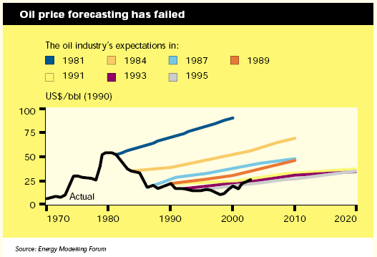
Longer Term Planning
Source: Scenarios: An Explorer’s Guide, Shell International 2003.
Notes:
8
Source: http://www.shell.com/static/royal-en/downloads/scenarios/scenario_explorersguide.pdf
This chart shows the price of oil from 1970 to 2003 – this is the dark black line.
Each of the colored lines represent the future oil price estimates at different points in time. So the dark purple one is the projection in 1981.
Ask the audience what they notice. they will usually respond that the forecasts re wrong – press the question of “How are they wrong?”
The key points to take away are:
Forecasts tend to be linear in nature – humans do not plan for step changes in the future
These forecasts are boxing point forecasts.
The slope of each projection is correlated to the current variability in the price of oil. Steeper indicates more volatility.
This is a reflection of the forecasters being “provencial” in time. The recent history is heavily influencing their forecast. This is called anchoring.

Slide 9
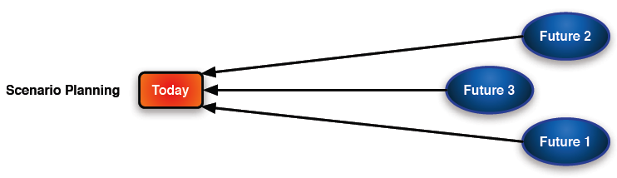
Different Methods for Planning
Time
Planning Horizon
But what about very long
term (10 to 30+ years) planning?
Shift focus from prediction to preparation
Notes:
9
So, here we are back to our problem. How do we handle long term planning if the traditional point and range forecast methods are insufficient?
Scenario Planning is one approach that can be used to help an organization to prepare for the long term. Rather than using the most recent history and projecting forward (like boxing) instead we flip the tables and start with a potential future. BUILD
Then we ask “For this future, what should we do TODAY if I know that this specific future is going to happen?” This is more like judo – not boxing. I am receiving the future and reacting and responding to it.
Rather than predicting what the future will be I am now preparing for it.
Ask the audience what the problem or flaw is with this approach. They will usually answer that you do not know what the exact future will be.
Respond by telling them they are correct. So, the challenge for Scenario Planning is to find the right number of “plausible” futures to prepare for. Obviously we cannot plan for all potential and plausible futures – there is not enough time.

Slide 10
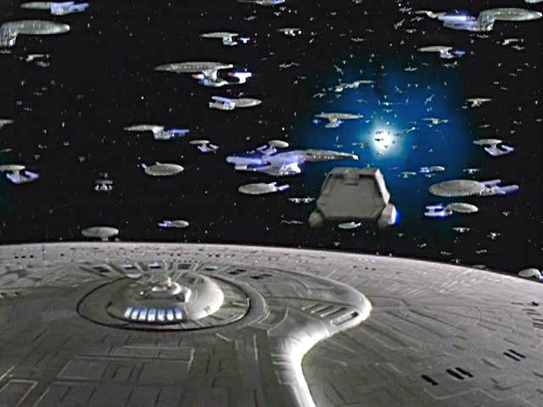
So many potential futures, so little time . . .
Notes:
As an example, take this picture. It is from Star Trek Next Generation series – the episode is “Parallels”. Aired in November 1993 in the seventh season. Plot Summary: After returning from a bat'leth tournament, Worf finds himself shifting between various realities of existence. This picture shows the 285,000 possible Starship enterprises.
This is your problem – which future should you select?

Slide 11
Preferred vs. Probable vs. Plausible
Possible Futures
Preferred Future - VISION
Probable Future
- PREDICTION
Now
Because we can’t explore ALL possible
futures, we must create a handful of plausible,
alternative futures that together contain the
most relevant uncertainty dimensions
Notes:
There are many different ways to select a potential future to prepare for. However, we should identify a couple specific futures.
A Preferred Future is a vision. This is a future that we hope will happen. An example is President Obama’s goal to double US exports within five years. this is a vision.
A Probable Future is a prediction. this is a future that you or your organization thinks is most likely to happen. This is essentially a single point forecast.
We do not want either of these to be included in our scenario planning.
Why? Because just like current events can anchor and bias our short term forecasts, having either Preferred or Probable futures among the scenarios that we are using will bias us. The other scenarios will be ignored.
Instead, focus on some plausible scenarios. We want to only select a handful (any more than 4 becomes overwhelming) of scenarios that are structurally different from each other.
Luckily, there are some pretty well established methods for forming scenarios. Lets look at the criteria for a good scenario.

Slide 12
Scenario Planning
Criteria for a good set of scenarios
  Decision Making– capture right decision
  Plausibility – within realistic limits
  Alternatives – no favorites or preferred (Unofficial/Official)
  Consistency – internal logic is aligned
  Differentiation – structurally different
  Memorability – easy to recall after event (name helps)
  Challenge – push against established wisdom
Accuracy of event forecasting is not important
  The skill we are developing is preparation not predicting
  The focus is on effects not on individual events
Source: Scenario Planning, Lindgren & Bandhold (2009)
Notes:
This list comes from Lindgren & Bandhold.
Decision Making– the scenarios should be designed around the critical strategy or decision you are trying to make. The FFF scenarios are all about the physical flow of freight.
Plausibility – the scenarios should be within realistic limits. Avoid “magic” technology or absurd assumptions (there is no more war).
Alternatives – among the set of scenarios, there should be no favorite or preferred scenario. Make sure that one of the scenarios is not an “Unofficial/Official” version. Each scenario should be equally likely/unlikely and likable/unlikeable.
Consistency –The internal logic has to be aligned. You should not have a scenario where, for example, GDP is very low but everyone’s household income is tripled. The logic has to work.
Differentiation – Each of the scenarios should be structurally different from each other. You don’t want scenarios that are too close to each other.
Memorability – The scenarios should be easy to recall after the workshop. A catchy name helps. The scenarios will be used as “touchstones” to refer to potential events. Make them memorable
Challenge – push against established wisdom. The scenarios should not be too safe. Remember, this is a brainstorming exercise.
The last point is critical. The scenarios that are used will probably never actually happen. That is ok. The real skill we are developing is the ability to look beyond today’s environment and to prepare for unforeseen situations.
Also, it is important to separate out effects from events.

Slide 13
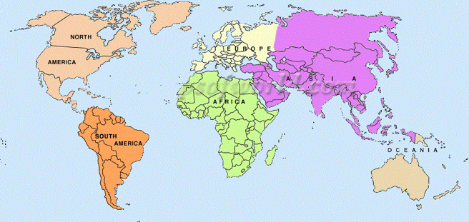
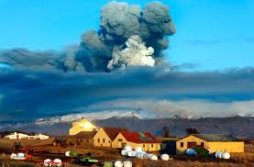

Effects versus Events
14 April 2010
Eruption of the Eyjafjallajökull Volcano
Summer 2008
Manufacturing moratorium in Beijing
Notes:
Lets talk about events versus effects. The idea is that there are many many individual and unique EVENTS that could all have the same EFFECT.
Take for example the EYE – a – fyat – la – jo – kutl volcano. The net effect of the volcano was the closure of the air traffic lane over the Atlantic for several months. No one predicted the volcano, but there are many other events that could have triggered the same effect of no air transport between the US and the EU – such as exceptionally high fuel costs, extreme trade barriers, etc. ,
Another example is the Beijing Olympics. Prior to the Olympics the government started closing down industry within a widening distance from the Olympics site due to pollution. At that time a large percentage of the Latex glove manufacturing for the world occurred within 50 miles of Beijing. This event (closure of manufacturing) casued a severe shortage of gloves – impacting a range of industries – healthcare to fast food. But, many different EVENTS could have triggered the EFFECT of stopping sourcing from China. These include a pandemic, natrual disasters, etc.
The key point is that we can never predict all of the potential events that can happen. We can, however, think about our operations and organization and identify the core EFFECTS that would impact us. This is a way of boiling down the ocean to a manageable number of things to prepare for

Slide 14
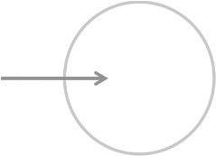

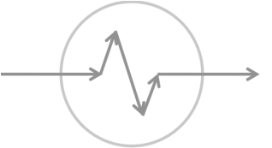

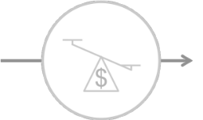
Translating Events into Effects Freight Flow Patterns
Impact on sourcing patterns
Where are raw products and WIP sourced from?
Are materials sourced in or out of the region?
Impact on flow destination
Where is the demand located? How are final
destination locations distributed?
How can an
event impact
freight flows?
Impact on routing
How is freight moved within the region? Are there
intermediate shipment points or mode switches?
Impact on flow volume
How will the total volume of freight shipped in and
through the region change?
Impact on value density
How will the product characteristics change? How
does the value density change?
Notes:
For our problem – investing in freight transportation infrastructure – we can identify 5 core EFFECTS that will result from any potential EVENT. Thus, I only need to really be prepared for this small set of EFFECTS.
These are: sourcing location, destination locations, intermediate locations for routing, total volume, and the characteristics of the products being moved. Value density is a proxy for the type of product.

Slide 15
The Real Value of Scenario Planning
Forecasting Challenges
  Without step changes, forecasting would be easy!
  Step changes are driven by events, and . . .
  Events are next to impossible to predict, but . . .
  Planners do a pretty good job preparing, so . . .
Scenario planning allows us to shift from
Predicting future Events
To
Preparing for potential Effects
Notes:
So, bringing this all together, we can see that the challenge of forecasting is that there are these step functions or changes that we cannot predict and that these make the long-range planning difficult.
However, Scenario Planning allows us to shift from predicting to preparing and to focus on a few key EFFECTS versus an infinite number of EVENTS.

Slide 16
Future Freight Flow Scenarios
Notes:
So, now lets turn to the scenarios that we will be using going forward.

Slide 17




Future Freight Flow Scenarios
Four FFF scenarios were created for November 2, 2037
Need to suspend belief for the exercise
It is helpful to look backwards 20-30 years . . .
Is this the future you imagined?
Notes:
The research team created four scenarios for use in the FFF Scenario Planning workshops. Lets talk about each of them:
Global Marketplace is a highly competitive and volatile world. Open, vigorous trade between virtually all nations has led to market-based approaches to most contemporary challenges. It is like Thomas Freidman’s Flat World on steriods.
One World Order is a highly regulated and managed world. Facing global scarcity of key resources, nations establish international rules to ensure their fair and sustainable use. Global trade thrives, but its course is shaped by the very visible hand of regulation, at times an iron fist in a velvet glove.
Millions of Markets is a world where advanced technological breakthroughs have enabled the United States (and other countries) to become highly self-reliant in terms of energy, agriculture, manufacturing, and other needs. There is increased migration towards smaller urban areas that are supported by nearby regional innovation hubs that can manufacture highly customized goods.
Naftástique! is a world where trade has moved away from a single global market towards a number of emerging regional trading blocs. China, Europe and South America form their own clusters. The United States leads an effort to make North America a self-sufficient economic community.
Each of you has been assigned to one of these worlds and in a few minutes you will be asked to immerse yourself into it. To make the exercise worthwhile, it is very important that you truly accept the future that you are assigned. It is hard for professionals to consider a potential future that is not either their preferred or predicted future. You need to free your mind and not get shackled to today’s conditions.
To help you “free your mind” lets talk about some examples of people who were tethered to their current thinking.

Slide 18
[either use the next several slides or play the “Free_Your_Mind.mp4” video]
Notes:
The video is on the data and the dvd disk in the toolkit

Slide 19
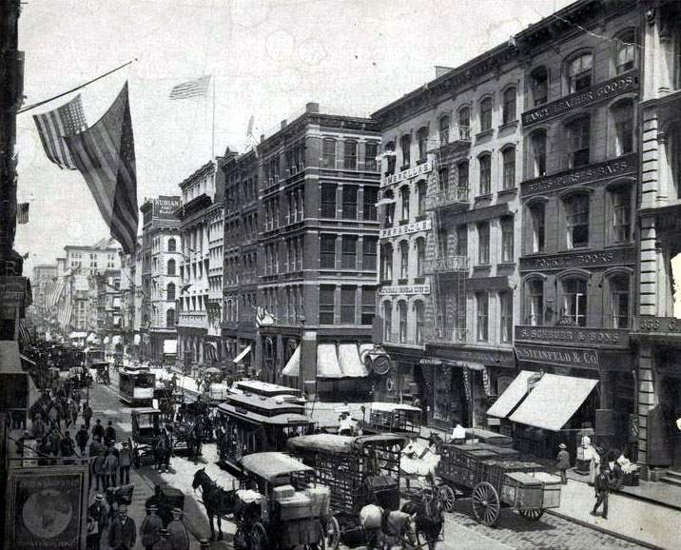
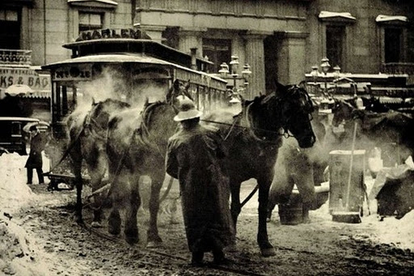
Classic Cases of Short Sightedness
Great Horse Manure Crisis of 1894
  More than 150,000 horses in NYC producing over 2,000 tons of manure per day
  Estimates of manure reaching 3rd floors by 1930 & nine feet in London by 1950
  1st International Urban Planning Conference held in NYC in 1894
Interestingly, over 4000 cars were
sold in the US in 1900. By, 1916
more cars than horses were
registered in NYC
Notes:
Give the rough background:
Urban transportation had become dominated by the horse drawn carriages and buses by the late 1800’s.
Horse population in New York City exceeded 150,000. Each horse produced between 15 and 30 pounds of manure each day –more than 2 million pounds EVERY DAY.
In 1894, the Times of London estimated that by 1950 manure would be 9 feet high on every street in London. In New York City, manure would reach the third floor of buildings by 1930.
first International Urban Planning conference held in New York City was canceled after just three of its planned 10 days. The reason? They could not foresee any possible solution to the horse manure problem in cities around the world.
Atomobile had already moved from the laboratory to full-scale production.
By 1900, over 4000 cars were sold in the US, and by 1912 (the first year New York City registered more cars than horses) the number was 356,000.
The planners could not see beyond the traditional horse drawn traffic.

Slide 20


Classic Cases of Short Sightedness
The Quartz Crisis/Revolution
  Swiss watchmaking industry dominated the global market after WWII
  In 1960, they held over 50% market share
  New quartz technology was introduced in the late 1960’s- Swiss firms ignored
  By 1970’s, US & Japan firms dominated and Swiss firms had less than 10% of market
Interestingly, the Quartz technology
was first developed by Max Hetzel,
a Swiss engineer!
Notes:
Give the rough background:
example, the Quartz Crisis that occurred in the 1970’s. The Swiss watchmaking industry dominated the world market for mechanical watches after World War II peaking in the late 1960’s when they captured approximately 50% of the total worldwide market! But, within a little more than a decade, they accounted for less than 10%. The cause was the introduction of the Quartz Movement that displaced the need for mechanics. Ironically the innovation was developed by a Swiss engineer and offered to the domestic watchmaking industry – they refused to see the value. Japan and the United States, on the other hand, did not miss the opportunity and soon were producing the majority of the world’s watches using this new technology. This is why in those countries this is referred to as the Quartz Revolution, rather than a crisis. The Swiss industry was convinced Quartz was a fad and only belatedly caught on – but not before they lost their historical advantage.
A quartz watch relies on the ability of quartz to resonate at a very specific frequency when stress is applied, generating a small electrical charge (the piezoelectric effect).
Again, the established industry could not see beyond its historical lenses.

Slide 21
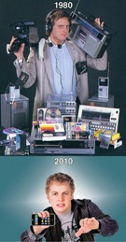
Suspend Disbelief: Technology
Communication
  No Internet, e-commerce or email
  AT&T had phone monopoly
  Car phones – late 1980’s
Technology Adoption – in 1982
  Microwaves were in 14% of homes
  VCR’s in < 1%
Consumer Electronics
  Digitization & miniaturization
Notes:
You can also tell the audience to think back 20-30 years. A lot can happen in a few decades. Look at some examples

Slide 22
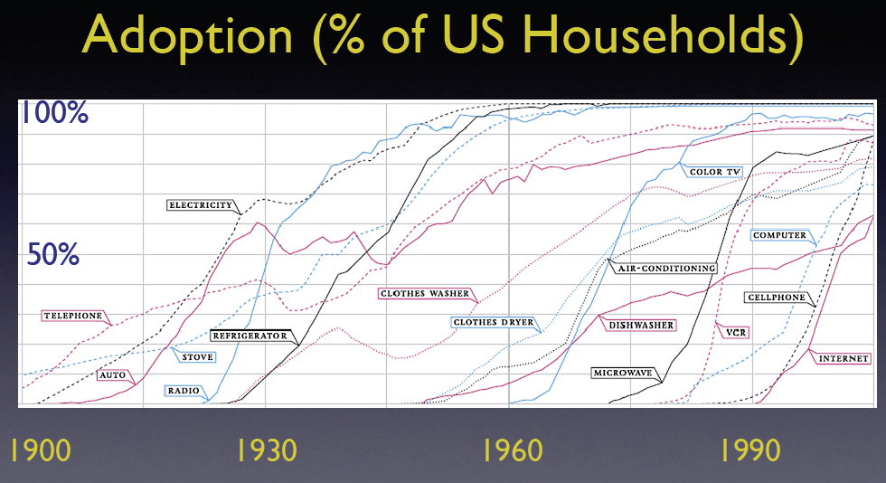
US Technology Adoption Rates from 1900 to 2005
Source: Source: Catlett, Charlie, “Technology adoption rates: historical perspective,”
International Science Grid This Week, Argonne National Laboratory, http://www.isgtw.org/?pid=1001793, accessed June 2011.
Notes:
This chart shows how new technologies can be adopted very quickly at times.

Slide 23

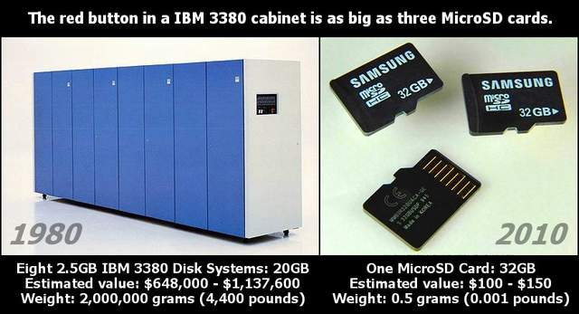
Suspend Disbelief: Technology
2011
32GB $54
Source: http://thenextweb.com/shareables/2010/03/21/20gb-1980-32gb-2010-pic/
Notes:
Point out that the cost of 20GB of storage in 1980 was ~$1M and weighed two tons. Now it fits in your pocket and costs less than $60. Even lower currently.

Slide 24
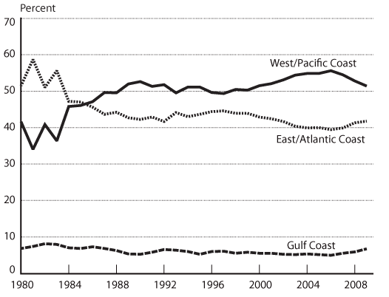
Suspend Disbelief: Economics
Global Trade 1981
  Just under 2/3 of all containers came via East Coast ports
Notes:
http://www.bts.gov/publications/americas_container_ports/2011/html/figure_12.html
This change does not have to happen in just technology. Look at the change in flow of container traffic from East to West Coast over a short period of time.
Ask them what caused this? Point out that China is now our 2nd largest trading partner, but in 1980 they were 24th – behind that powerhouse, Switzerland.

Slide 25



Suspend Disbelief: Economics
Changes in Industries
  Large ones have fallen - Bookstores
  New ones have emerged (and are changing) - Amazon
  Some have come and gone – VHS Rental
Notes:
http://www.bts.gov/publications/americas_container_ports/2011/html/figure_12.html
There are also business examples. Take bookstores. The movie “You’ve got mail “(1998) showed a world where the national book stores taking over the industry. In 2003 there were 1250 Borders stores. They filed for bankruptcy in 2011.
Take video rentals. Blockbuster – Founded in 1985 – opening a store every 17 hours in the early 1990’s. They had 60,000 employees in 2009! Finally, they were bought by Dish Network out of bankruptcy in 2010
Amazon initial slogan: The world's largest bookstore now
We seek to be Earth’s most customer-centric company for three primary customer sets: consumer customers, seller customers and developer customers.

Slide 26
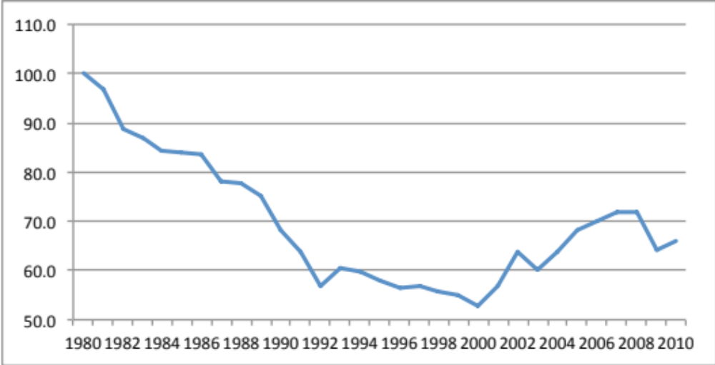
Suspend Disbelief: Political
1980 Communism was alive and well
  1983, Princeton University professor Stephen Cohen described the Soviet system as “remarkably stable.”
  1989 Berlin Wall falls
Deregulation of Transportation
  1980 - Staggers Act, Motor Carrier Act
  1986 - Surface Freight Forwarder Deregulation Act
Index of Revenue per Mile
for US. Trucking in Real $
Notes:
Rapid change can also happen in politics. Look at the fall of the Berlin Wall.
Also, look at the transportation deregulation that occurred in the US in the early 1980’s. The net effect was a dramatic decrease in the cost paid to carriers. Dramatically changed sourcing patterns, routing, volumes shipped, etc.

Slide 27
Future Freight Flow Scenarios
Just as a lot has happened over the last 30 years, a lot can happen in the next thirty!

Slide 28
So, what we will do?
Conduct Divergent and Convergent Exercises
Concurrent Breakout Sessions
  Each person has been assigned to one scenario
  Facilitated brainstorming sessions
  Consider potential freight infrastructure corridors & initiatives
  Objective is to develop and share insights!
Collective Debrief
  Identify robust investment strategies
  Identify conditional strategies along with triggers
Notes:
So, now that our minds are free, lets talk about what we will do next.
Each of you has been assigned a scenario. You will break up into separate groups and for the next hour or so will immerse yourself in it and try to answer the key question that you have been assigned. We will show you a video and talk about the brochure that you have been provided to help in the immersion process.
These are called Divergent Sessions because they are meant to be brainstorming engagements where ideas will come from anywhere. The thinking will diverge all over the place.
After this, we will reconvene as a single group. this is where we converge. We will compare and contrast the different strategies and suggestions each group came up with to hopefully identify some robust strategies. .

Slide 29
FFF Workshop
Process Overview (ALL)
Global
Marketplace
Naftastique!
Millions
Of Markets
One World Order
Scenario
Immersion
Segments
Segments
Segments
Segments
Evaluation
Mechanism
Feedback &/or Evaluation
Feedback &/or Evaluation
Feedback &/or Evaluation
Feedback &/or Evaluation
Convergence &
Reconciliation
Debrief
(ALL)
No Brainers
No Gainers
No Regrets
Contingencies
Notes:
Here is a graphical representation of the rest of today. We will split into our groups and then reconvene to converge, compare and reconcile the different strategies.

Slide 30
Tasks to Complete in Breakouts
Scenario Immersion (Living in a KNOWN Future)
  Review scenario brochures
  Watch newscast videos
  Discuss global, national, and regional impacts
Key Strategic Question(s) (Now for KNOWN Future)
  [ENTER THESE IN FOR YOR WORKSHOP]
Notes:
When you are in your breakout sections, you will be asked to assume that you are living in that specific future world. We will help with the immersion process.
When you answer the strategic questions, this will based on what you should do TODAY assuming that the assigned future will happen
Enter in what the strategic question is for your workshop. this is what you want them to answer.

Slide 31
Strategic Question 1: Where should infrastructure investment be placed?
Individual Component Voting
  15 chips per person
    12 Invest Chips (red or white – color does not matter)
    3 Veto Chips (Black with Skull & Crossbones)
  More invest points = more important in scenario
  You must use all 12 of your invest chips
  You must use at least 1 veto chip but no more than 3
  You cannot have both Invest and Veto chips on same segment
  You may place invest chips on non-listed initiatives (write in)
Team Segment Voting
  After discussion, you may change your own votes
  Teams can have both Invest and Veto chips on same bundle
Notes:
THIS IS ONLY A SAMPLE – put in your question.
the voting rules can be modified. See the Planners Guide for details.

Slide 32
Strategic Question 2: What should the level of investment be?
Individual Component Voting
  9 chips per person – all colors are ok
  Indicate the level of investment for infrastructure categories
    Maintain Existing Infrastructure – status quo maintenance and repair
    Improve Existing Infrastructure – improve flow through facilities
    Add New Infrastructure – build new facilities
  One chip must be placed for each component (one per row)
  You must use all 9 of your invest chips, but
    No more than 2 chips can be placed in the Add New level
    No more than 3 chips can be placed on the Improve Existing level
Team Segment Voting
  After discussion, you may change your own votes
Notes:
This is an optional second question to have th teams discuss

Slide 33
Strategic Question 3: Level of Policy and Funding Sources
Level of Policy
  9 chips per person – all colors are ok
  Where should policy be made for this component:
    Federal or national level
    State or regional level
  One chip must be placed for each component (one per row)
Primary Funding Source
  9 chips per person – all colors are ok
  Where should primary funding come from for this component:
    Public Sector Alone
    Private Sector Alone
    Public Private Partnerships
  One chip must be placed for each component (one per row)
Notes:
An optional third question

Slide 34
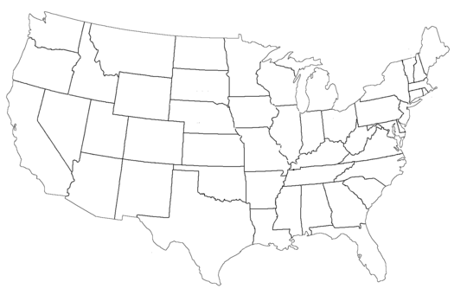
Infrastructure Components
Gateways
  East Coast Water Ports
  Gulf Coast Water Ports
  West Coast Water Ports
  Border Crossing: Mexico
  Border Crossing: Canada
  International Airports
Corridors
  Gateways to/from Population Centers
  Gateways to/from Production Locations
  Population Centers to/from Production Locations
Connectors
  Gateway to Corridor Connections
  Intermodal Connections
  Feeder Lines to Corridor
Notes:
THIS IS ONLY A SAMPLE – put in your segments or components.
The use of gateways, corridors, and connectors is not a bad framework to use in your region.

Slide 35
So, lets go!
How to engage in workshop?
  Live in the scenario – don’t debate it’s probability!
  Suspend your disbeliefs – remember your 1980’s wardrobe
  No criticism, ridicule of any opinions
  Have fun!
  Most valuable input is your insights
Scenario facilitators
  One World Order– [Enter Facilitators Name]
  Naftastique! – [Enter Facilitators Name]
  Millions of Markets – [Enter Facilitators Name]
  Global Marketplace – [Enter Facilitators Name]
Notes:
Final words before starting the breakout sessions.

Slide 36
Questions?
Notes:
Discuss Transportation Network Design
Structure of Networks

