Slide 1
Debrief for the
Future Freight Flows
Scenario Planning Workshop
Your Name
Date
Organization
Notes:
These slides are intended to be used by a facilitator at a Future Freight Flow (FFF) Scenario Planning workshop. The slides were developed as part of the Scenario Planning Toolkit for the NCHRP 20-83-(01) Project.
The notes are meant to help the facilitator make key points – they are not meant to be used as a script.
This ppt is used during the converge portion of the workshop – the debrief. It utilizes the file “Workshop_Debrief_XLS_Template.xlsx”

Slide 2




Four Future Freight Flow Scenarios
Notes:
Before we get into comparing each of the different strategies, lets expose everyone to all of the scenarios. So far, each of you have only been immersed in one and only one.
[PLAY THE VIDEO “Summary_of_FFF_Scenarios.mp4”]

Slide 3



Key Ideas
Fast paced, Interconnected, Chaotic, Minimal
Government intervention, Commercial
Heavy handed, Regulated, Slower pace,
Feel of 1970’s PBS broadcast, Strong government
Self-Reliance, Merging cultures, Trading Blocs, Re-domestication of manufacturing
Mfg. clusters, Make close to consumption,
Dispersed demographics, Nuclear renaissance
Notes:
AFTER THE VIDEO –
Talk through the key attributes of each scenario. Get the audience to participate heavily in this discussion.

Slide 4


Differences Between Scenarios
Global Trade | Low | High | High | Low (physical)
Resource Availability | Low | Low | High | High
Energy Cost Level | High | High | Low | Low
Energy Cost Variability | Low | High | High | Low
Level of Environmental Awareness | Same as Today | High | Low | High
Population Dispersion | Growth in SW | Growth in Biggest Cities | Growth in Biggest Cities | Rise in Mid Tiered Cities
Energy Sources | Majority NA | Mix Foreign & Domestic | Majority Foreign | Majority Domestic
Level of Migration | High w/in Bloc, Low between | High | High | Low
Migration Policy | High | High | Low | Low
Currency Fluctuations | Low w/in Bloc | High | Moderate | Low
Notes:
The scenarios were developed over the course of several months and are based on surveys, interviews, and input from academics, researchers, practitioners, planners, futurists, etc.
The structural axis of the scenarios comes from the two driving axes of uncertainty: Global Trade and Resource Availability.
This table shows how some other factors differ across the scenarios.

Slide 5
Results from individual scenarios
Notes:
Now lets get to the debrief.

Slide 6
Global Marketplace: Voting results
Notes:
THIS IS A SAMPLE SCREEN SHOT. PULL YOUR OWN GLOBAL MARKETPLACE RESULTS FROM THE SPREADSHEET “Workshop_Debrief_XLS_Template.xlsx”, on the Global Marketplace tab
Have a leader from each breakout session explain their voting and the reasoning behind it.

Slide 7
Global Marketplace: Level of investment
Notes:
THIS IS A SAMPLE SCREEN SHOT. PULL YOUR OWN GLOBAL MARKETPLACE RESULTS FROM THE SPREADSHEET “Workshop_Debrief_XLS_Template.xlsx”, on the Global Marketplace tab
Have a leader from each breakout session explain their level of investment and the reasoning behind it.
THIS IS OPTIONAL AND IS ONLY USED IF YOU HAD THE TEAMS ANSWER THIS QUESTION.

Slide 8
Global Marketplace: Funding sources, policy level
Notes:
THIS IS A SAMPLE SCREEN SHOT. PULL YOUR OWN GLOBAL MARKETPLACE RESULTS FROM THE SPREADSHEET “Workshop_Debrief_XLS_Template.xlsx”, on the Global Marketplace tab
Have a leader from each breakout session explain their funding sources and the reasoning behind it.
THIS IS OPTIONAL AND IS ONLY USED IF YOU HAD THE TEAMS ANSWER THIS QUESTION.

Slide 9
Millions of Markets: Voting results
Notes:
SEE GLOBAL MARKETPLACE SLIDES – DO THE SAME HERE

Slide 10
Millions of Markets: Level of investment
Notes:
SEE GLOBAL MARKETPLACE SLIDES – DO THE SAME HERE

Slide 11
Millions of Markets: Funding sources, policy level
Notes:
SEE GLOBAL MARKETPLACE SLIDES – DO THE SAME HERE

Slide 12
Natfastique!: Voting results
Notes:
SEE GLOBAL MARKETPLACE SLIDES – DO THE SAME HERE

Slide 13
Naftastique: Level of investment
Notes:
SEE GLOBAL MARKETPLACE SLIDES – DO THE SAME HERE

Slide 14
Naftastique: Funding sources, policy level
Notes:
SEE GLOBAL MARKETPLACE SLIDES – DO THE SAME HERE

Slide 15
One World Order: Voting results
Notes:
SEE GLOBAL MARKETPLACE SLIDES – DO THE SAME HERE

Slide 16
One World Order: Level of investment
Notes:
SEE GLOBAL MARKETPLACE SLIDES – DO THE SAME HERE

Slide 17
One World Order: Funding sources, policy level
Notes:
SEE GLOBAL MARKETPLACE SLIDES – DO THE SAME HERE

Slide 18
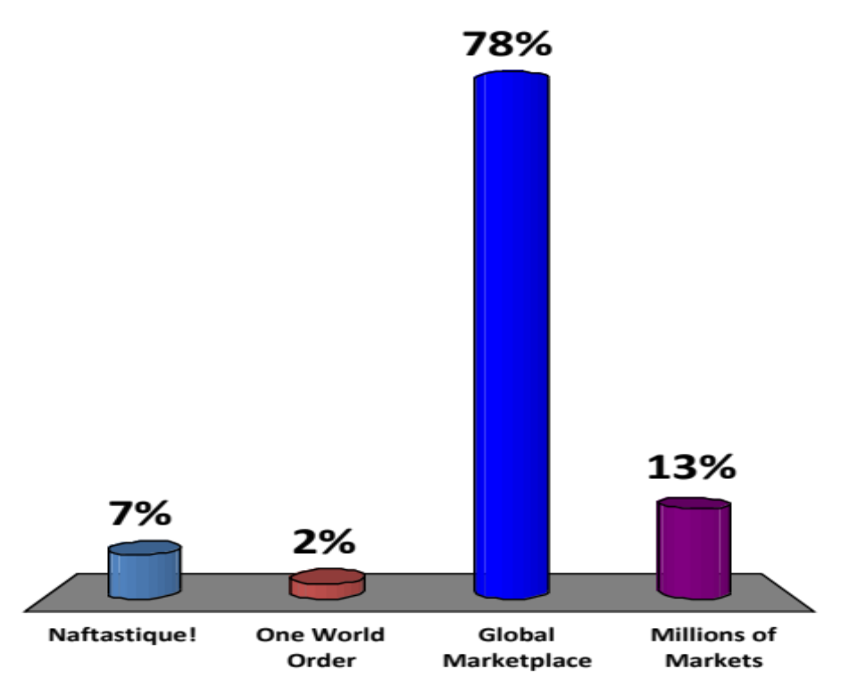



Which scenario seems most like TODAY?
55
45
Naftastique!
One World Order
Global Marketplace
Millions of Markets
Notes:
The next three slides are used to get the audience engaged in the discussion and to not just be passive listeners.
Ask the attendees – either by show of hands or with response cards – which scenario is most like today. Use this open discussion –
Why is this one like today?
What aspects make it most like today?
Why not the other scenarios?

Slide 19
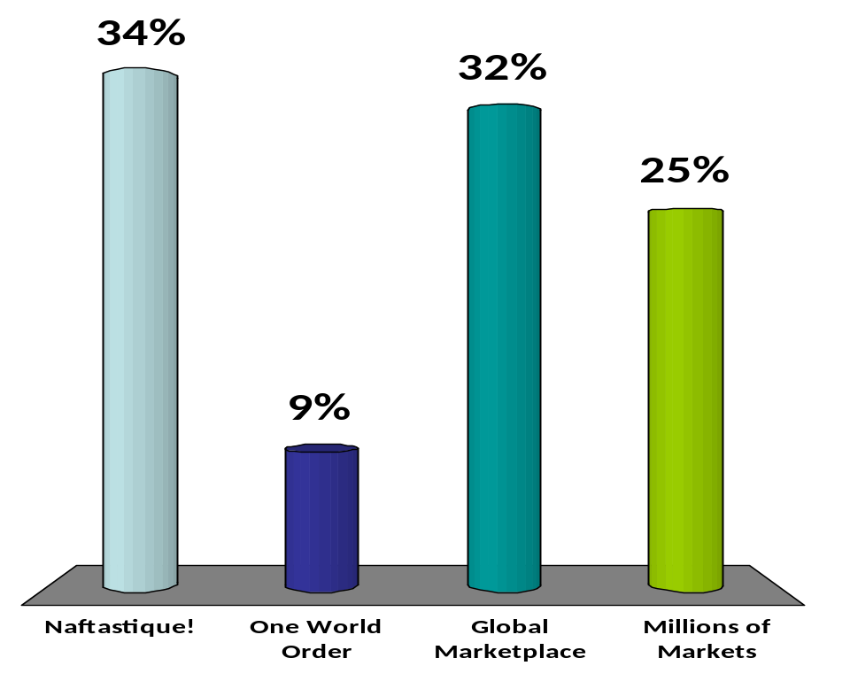
Which scenario is MOST LIKELY to occur?
55
44
Naftastique!
One World Order
Global Marketplace
Millions of Markets
Notes:
Ask the attendees – either by show of hands or with response cards – which scenario is most likely to occur. Use this open discussion –
Why this one?
What aspects make it most likely?
Why not the other scenarios?

Slide 20
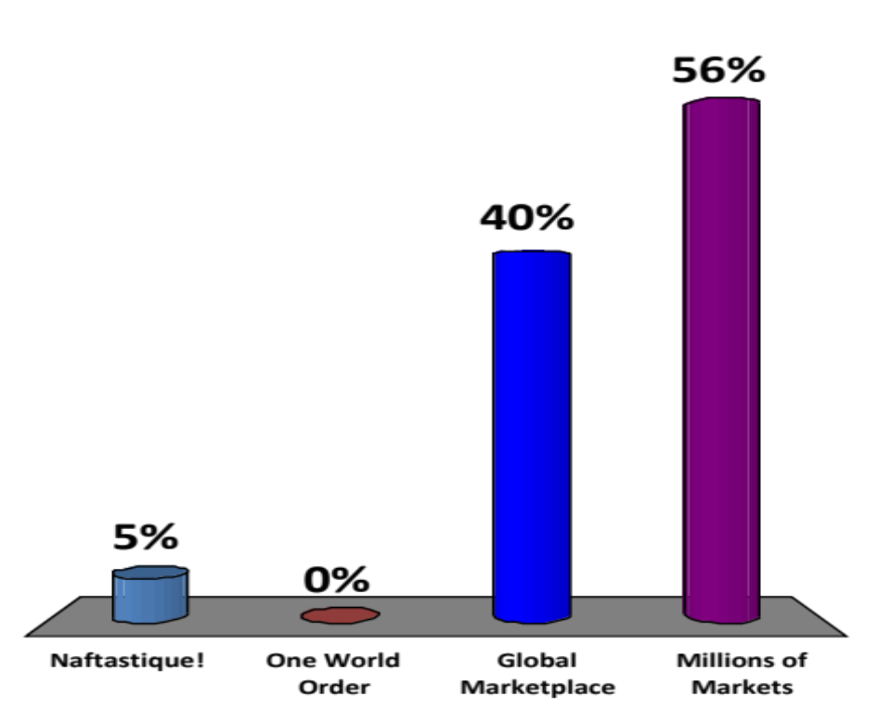
Which scenario do you PREFER to occur?
55
43
Naftastique!
One World Order
Global Marketplace
Millions of Markets
Notes:
Ask the attendees – either by show of hands or with response cards – which scenario you would prefer to occur. Use this open discussion –
Why this one?
What aspects make it most likely?
Why not the other scenarios?

Slide 21
Cross-scenario comparison
Notes:
Now we want to get to the meat of the debrief. How do the strategies compare across the scenarios?

Slide 22
Cross-Scenario Comparisons
Scenario Implications
Robust Implications
Contingent Implications
No
Brainer
No
Regret
No
Gainer
Detailed Review
Sensors
in the
Ground
Risk
Management
New strategy development process
Acid
testing
current
strategy
Notes:
22
Explain that when we run X-scenario comparisons, we are looking for insights and implications. The implications come in two flavors: Robust and Contingent.
Robust implications are those strategies or approaches that have similar outcomes across all of the scenarios.
Contingent implications are those strategies or approaches that make sense in some scenarios – but not in all.
For Robust Implications:
- No Brainers are those that make sense (good ratings) in all scenarios – These should be pursued further
- No Regrets – these are ones that make sense in some but are indifferent in the others.
- No Gainers – these are not desirable in any scenario – do not pursue them
For contingent Implications – these are the mixed ones. You want to dive deeper to understand
(1) why it is contingent,
(2) what aspects of the segment/option specifically make it contingent,
(2) what aspects of the scenario specifically make this segment contingent,
You will want to lead the group to then develop “Sensors in the Ground”. A SITG is a metric or data point that indicates that the world is moving towards (or away) from a particular world. This way, the organization knows when to consider implementing one of the contingent strategies.
Now lets look at your results – and lets identify the robust and contingent strategies.

Slide 23
All scenarios: Voting results
Notes:
THIS IS A SAMPLE SCREEN SHOT. PULL YOUR OWN COMBINED RESULTS FROM THE SPREADSHEET “Workshop_Debrief_XLS_Template.xlsx”, on the “All Scenarios” tab
Explain the chart:
- Each scenario corresponds to a color (Blue – global marketplace, Grey – Millions of Markets, Red – Naftastique!, Green – One World Order)
- Each column is a segment
- The bars above the horizontal 0% line are the percentage of positive votes for each segment for each scenario. Higher bar = more priority
- The bars beneath the horizontal 0% line are the percentage of the negative votes for each segment for each scenario. Longer bar = more negative veto votes.
- The triangles indicate a generally GOOD rating in that scenario. The color matches the scenario
- The X indicates a generally BAD rating in that scenario. Colors match scenarios
- The circle indicates an ambivalent or mixed rating in that scenario.

Slide 24
All scenarios: Level of investment
Notes:
This is all of the individual Q2 outcomes together.

Slide 25
All scenarios: Funding sources, policy level
Notes:
This is all of the individual Q3 outcomes together.

Slide 26
Wrap Up
Notes:
Discuss how the results of the workshop will be used going further
thank all participants.

