Slide 1
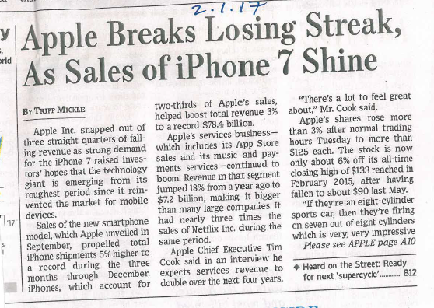
Apple Case Supplement: Some Relevant Headlines
WSJ 2-1-17
WSJ 7-20-16
Ref.: Wall Street Journal

Slide 2
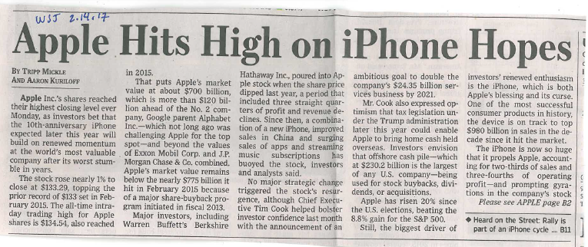
Apple Case Supplement: Some Relevant Headlines
WSJ 2-14-17
Hopes based on 10th Anniversary iPhone
Ref.: Wall Street Journal

